Slide 1

Tips for Reading with Children

Slide 2
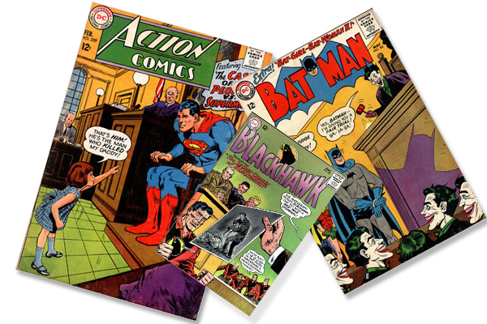
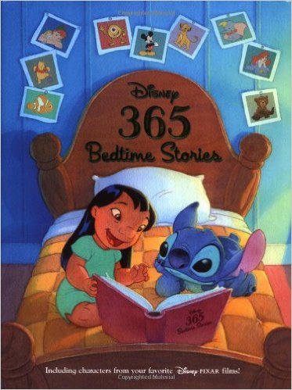

It’s Good to Share
Share books with your child alongside the school reading book your child brings home. These could be:
Picture books
Bedtime stories
Information books
Comic books
Magazines

Slide 3

Expression
Read with expression when reading to your child. Use different voices and vary the volume for effect.
Your children will love it!
Your children will start to read with expression when they are reading to you.

Slide 4

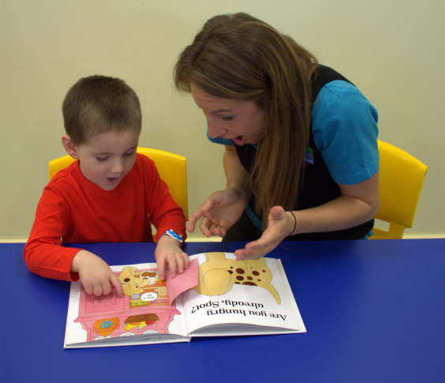
Talk about it!
Before reading a book together, always talk about the title, the pictures and the information on the cover (front and back).
If it’s new, ask what your child thinks the book might be about.
If it’s an old favourite then talk about the bits you love most! Don’t worry if some books get chosen again and again!

Slide 5
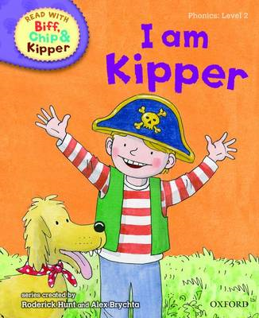
Age 4-5
Your child will be bring decodable books home from school. These are designed to help your child read independently and help them use their phonic skills. Be patient and impressed!

Slide 6
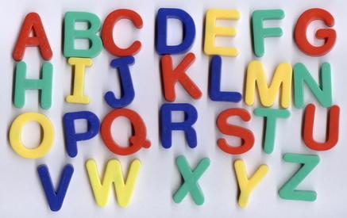
Letter Games
After you have read a book, play letter-spotting and word games like these with your child:
Can you find Dan’s name on this page?
Can you find the word ‘and’ on this page?
How many words can you find on this page that begin with ‘t’?
Get your child to ask you too!

Slide 7
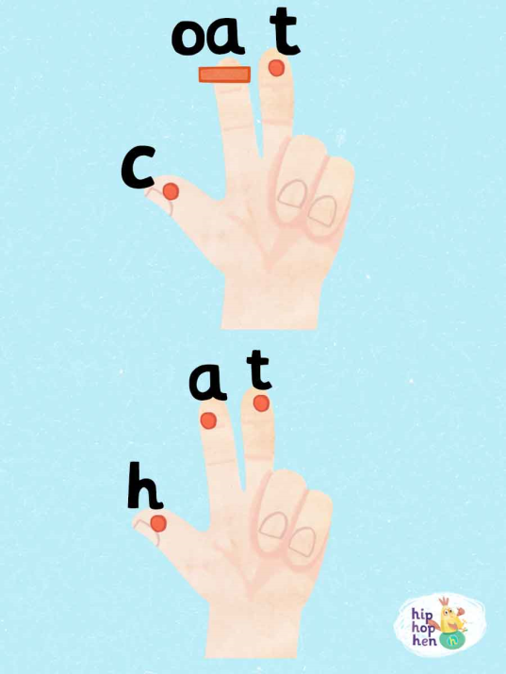
Sounding out
If your child gets stuck on a word, check first if it can be ‘sounded out’ or ‘blended’ by saying the letter sounds individually and putting them together quickly to hear the word. If your child can’t work out the word, then you say it and move on .

Slide 8

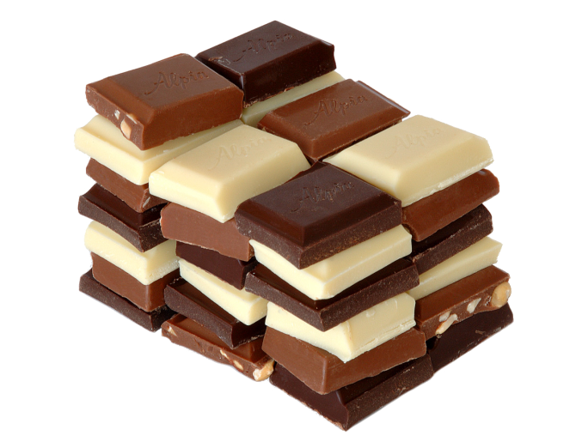
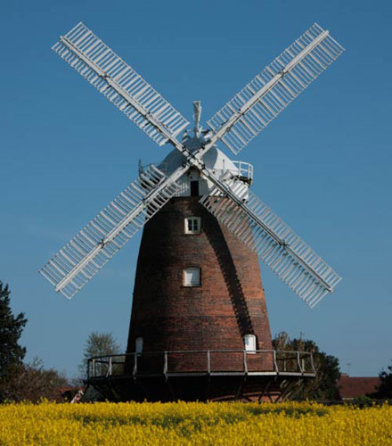
Clap and chunk!
Clapping out syllables or chunks in words and names can help with reading longer words: Di-no-saur! Choc-o-late!
Or point out that some words are made up of two words, so wind and then mill makes windmill.

Slide 9

Do not be afraid!
It’s sometimes good to get your child to re-read a sentence or even a page if it has been tricky to work out. This helps with meaning, flow and confidence – and we all still have to do this sometimes!

Slide 10
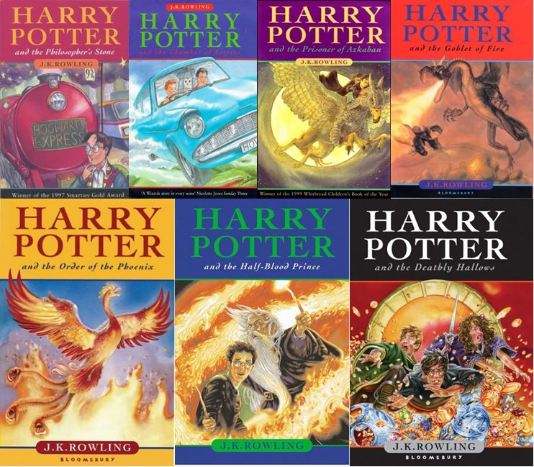
As children get older
Even children aged 7-11 like to be read to!
Read a story to your children that may be challenging for them to read but makes story-time more enjoyable.

Slide 11

Encourage Prediction
Always ask your children questions:
I wonder if … will happen?
Who do you think will…?

Slide 12

Value Choice
It’s really important to value your child’s choices even when a book looks too easy or too difficult. Children can read books that appear to be too difficult (especially if it is a topic that interests them) but you’ll need to guide them through, tricky words pictures, ideas or even the layout of an information book.

Slide 13

Resilience
As children read more challenging books be aware that there might be times when they struggle and seem reluctant– so help them through those patches by reading a bit with them to get them started or hooked into the next chapter. Always balance this with sensitivity and valuing their choice – it’s got to be fun!

Slide 14

Read! Read! Read!
It’s really important to read as much as possible with your child. Read the books that come home from school, borrow library books, buy books and magazines. Read signs and notices, and find interesting websites to read. And keep reading together at bedtime too!

Slide 15
Class Routines
Mon – paired reading
Tues- Fri Guided reading, spelling and handwriting activities.
Chn are grouped accordingly.
Grammar – is taught every Mon ( as a discrete lesson) and daily as part of a Literacy session.
A green dot in English books represents a Grammar session!

Slide 16
Spelling
  Weekly spellings given.
  Informal spelling test on a Fri am.
  Chn are expected to apply spellings given into their writing.
  Scaffolds – dictionaries and lists of key words for chn to self correct.
  Spelling errors are marked with sp and a wiggly line.

Slide 17
Spelling continued..
We follow the Babcock syllabus
If chn are unsure of a word they underline it and are expected to self correct.
A useful spelling activity where chn can check spellings independently is……
LCWSCh on www.ictgames.co.uk

