Slide 1
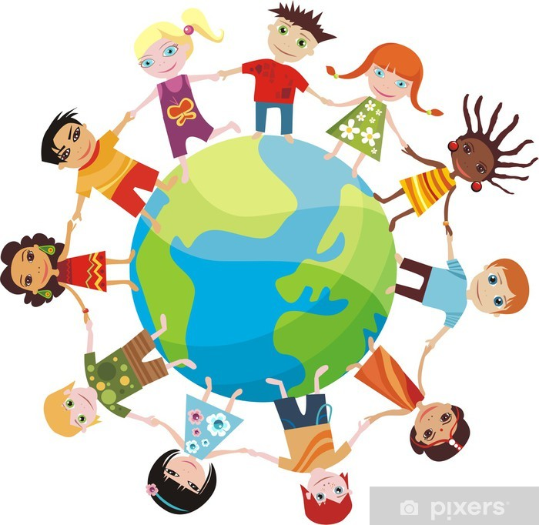

Slide 2
Twenty-fifth Sunday of Ordinary Time
Welcome: Today we hear how Jesus valued children and thought they were important. Let’s think about how important all children around the world are today.

Slide 3
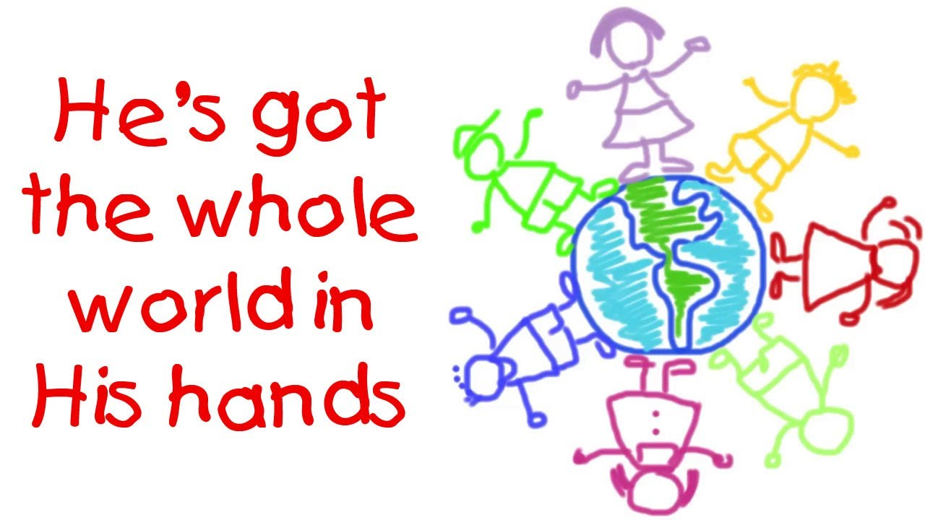
Hymn
He’s got the Whole world in his hands

Slide 4
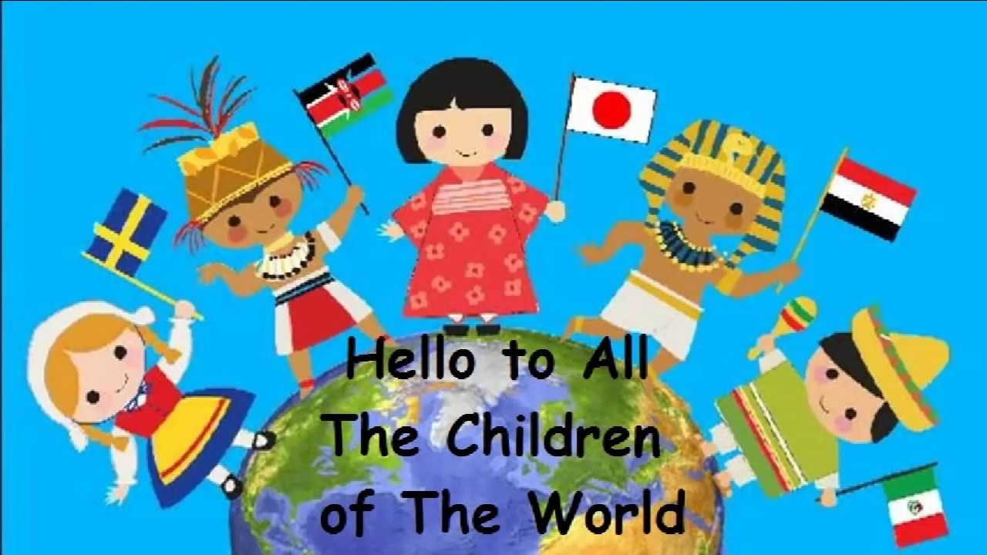
Opening Prayer
God of love, help us to recognise the importance of all children no matter where in the world they come from. Amen.

Slide 5
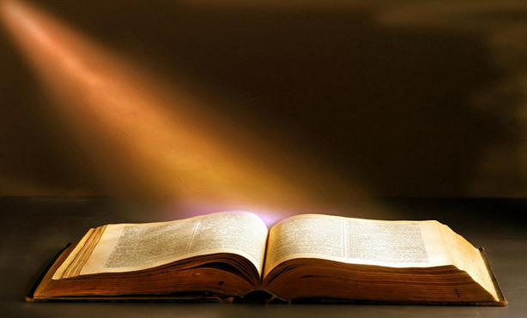
Gospel Acclamation
Alleluia, Alleluia, Praise the Lord
Alleluia, Alleluia, Praise the Lord
As we listen to the Story
Let us praise him for his glory
Alleluia, Alleluia Praise the Lord

Slide 6
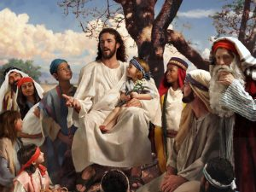
A reading from the Gospel according to Mark 9: 30-37

Slide 7
Gospel Acclamation
Alleluia, Alleluia, Praise the Lord
Alleluia, Alleluia, Praise the Lord
As we listen to the Story
Let us praise him for his glory
Alleluia, Alleluia Praise the Lord

Slide 8
Reflection
In today's reading Jesus shows the disciples how important children are. Can you remember what Jesus says?
Jesus says that anyone who welcomes a child, welcomes him. What do you think that means?
Jesus is in all of us. No matter who we are, where we come from, whether we are rich or poor, old or young. Even the youngest person is special and important because they are loved by God.
What will you do this week to show that all people are important no matter who they are?

Slide 9
Intercessions
We know that God loves us all, just because we are who we are, and so we have the confidence to pray together:
We pray for world leaders: that they may see the importance of all their people, especially children, and make decisions based on what is best for everyone. Lord, in your mercy…
We pray for all children throughout the world: that they may be valued and loved, and have the chance to build a brighter future. Lord, in your mercy…
We pray for our parish, families and friends: that we may welcome all people, no matter who they are, and do all that we can to help others to move forwards with hope. Lord, in your mercy…

Slide 10
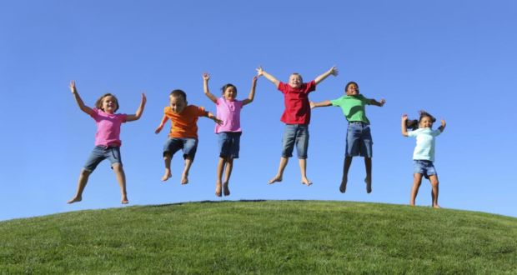
Closing Prayer
God of hope, we know that all people are important, because they are loved by you. Show us how to help others to see this too, so that the world can be a fairer place for all your children. Amen.

Slide 11
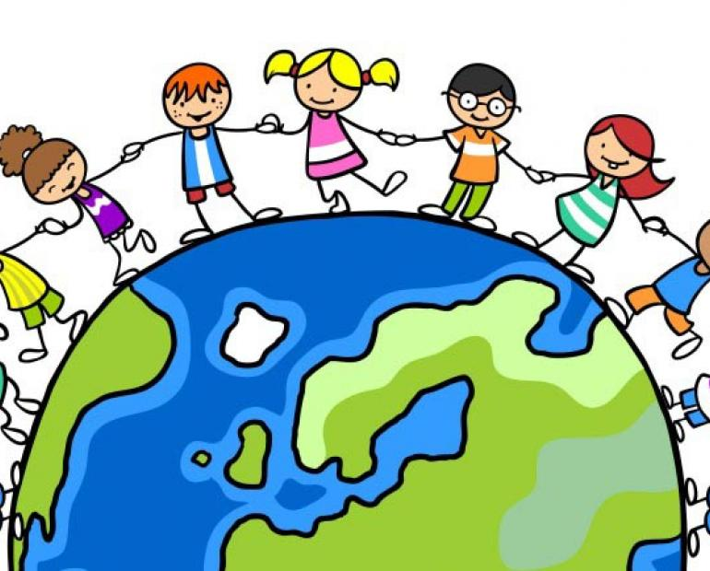
Commissioning
Go forth:Tell the people at home all that you have heard and thought about today. Try to do one thing in the coming week to help others and show that all people are important because they are loved
by God.

