Slide 1


Slide 2
Twenty-sixth Sunday of Ordinary Time
Welcome:Today we will reflect on how believing in Jesus can sometimes mean we have to make hard choices. As it is CAFOD’s Family Fast Day on Friday, we will also think about the choices we need to make to Go Green and protect and care for the beautiful planet earth, which is our home.

Slide 3
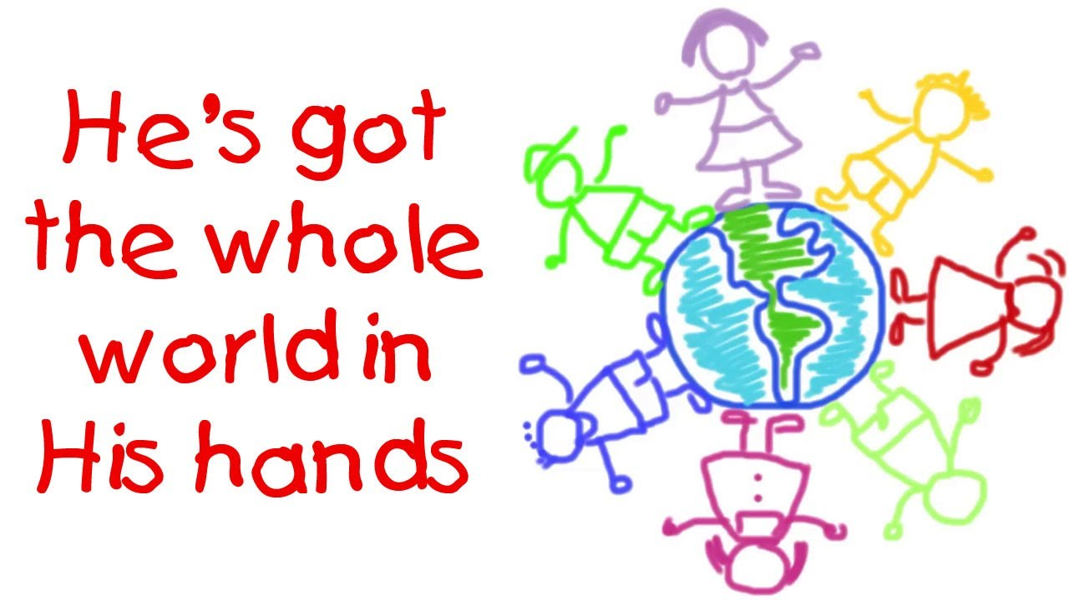
Hymn
He’s got the Whole world in his hands

Slide 4
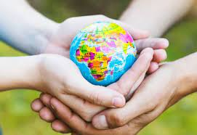
Opening Prayer
God of love, strengthen our faith and help us to make the right choices even when it is difficult. Amen.

Slide 5
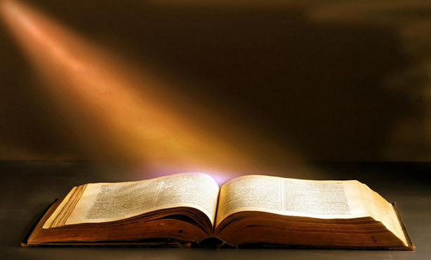
Gospel Acclamation
Alleluia, Alleluia, Praise the Lord
Alleluia, Alleluia, Praise the Lord
As we listen to the Story
Let us praise him for his glory
Alleluia, Alleluia Praise the Lord

Slide 6
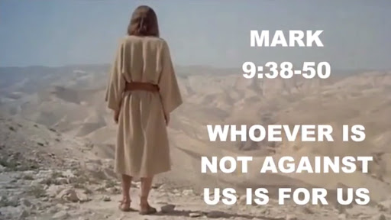
A reading from the Gospel according to Mark 9: 38-43

Slide 7
Gospel Acclamation
Alleluia, Alleluia, Praise the Lord
Alleluia, Alleluia, Praise the Lord
As we listen to the Story
Let us praise him for his glory
Alleluia, Alleluia Praise the Lord

Slide 8
Reflection
What do you remember about the gospel reading that we heard today?
Jesus tells the disciples that anyone who is not against him, who is not Jesus’ enemy, is his friend. And Jesus says that anyone who treats people well because they follow him will be loved by him and be rewarded in heaven.
Do you believe that Jesus is our friend, who loves and cares for all of us always? I do!
But how do we show that we are friends or followers of Jesus? What would Jesus like us to do?

Slide 9
Intercessions
Jesus calls us to help those who are in need. Let us remember this as we pray together:
We pray for all people throughout the world: that they may have their fair share of the gifts of creation, which have been given by God to us all. Lord, in your mercy…
We pray for all people who are working to protect the earth: that God may give them strength in their work and inspire us all to do what we can to care for the world. Lord, in your mercy….
We pray for our parish, family and friends: that we may be inspired to do the right thing even when it’s hard and to share what we have so that all people may have enough. Lord, in your mercy…

Slide 10

Closing Prayer
Generous God, we thank you for creating such a beautiful world. May we do all that we can to protect it for all people today and in the future. Amen.

Slide 11
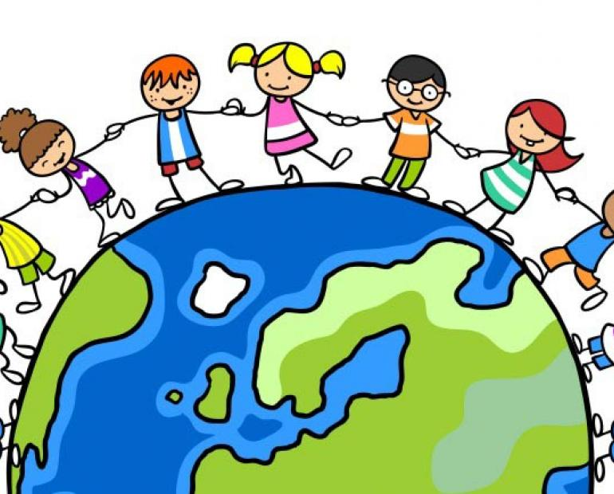
Commissioning
Go forth: Remember all that you have heard and thought about today. Do what you can to care for the environment and look after our
beautiful planet.

