Slide 1
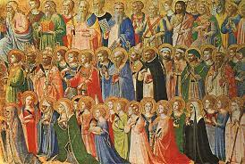
All Saints
Welcome: Today we celebrate the feast of All Saints, when we remember all the people who have lived their lives really well and who have died and gone to heaven. Let’s also think about how we can follow their example and live our lives as God wants us to.

Slide 2
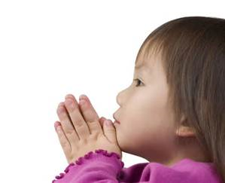
Opening Prayer
God of life, we give thanks for all the holy men and women who have lived throughout the world. Help us to live as you would like us to by showing love to all, bringing peace and always trying to do what is right. Amen.

Slide 3
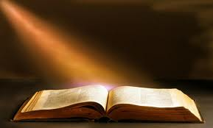
Gospel acclamation
Alleluia, Alleluia, Praise the Lord
Alleluia, Alleluia, Praise the Lord
As we listen to the Story
Let us praise him for his glory
Alleluia, Alleluia Praise the Lord.

Slide 4
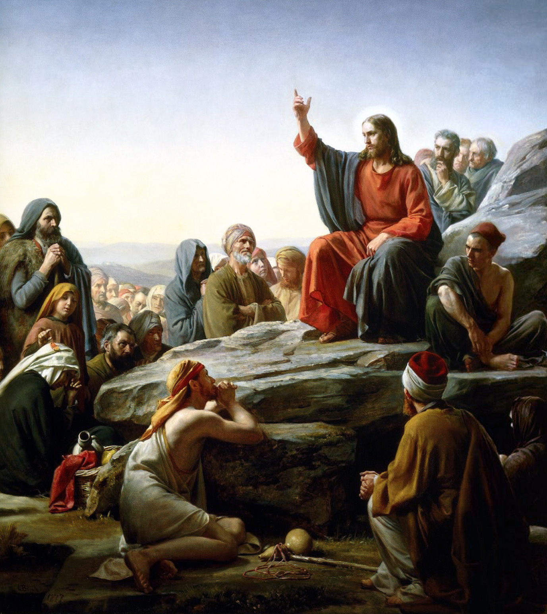
Gospel: Matthew 5:1-12

Slide 5
Gospel acclamation
Alleluia, Alleluia, Praise the Lord
Alleluia, Alleluia, Praise the Lord
As we listen to the Story
Let us praise him for his glory
Alleluia, Alleluia Praise the Lord.

Slide 6
Time to reflect……
What do you remember from today’s reading?
Today we hear Jesus telling us exactly what kind of person he wants us to be, and the kind of person that he has special love and care for.
Can you remember what he says?
We all know people who live like this – who really follow Jesus in their lives. It might be someone well known, who lots of people have heard of. Or it might be a friend or a family member. Let’s just think quietly about them for a moment.
We know there have been lots of saints in our world too. People who have lived their lives as God has asked of them. How many saints can you think of? Can you tell me some of their names?

Slide 7
Intercession.
We pray together to God, who loves and care for each one of us:
We pray for the Church throughout the world: that it may show God’s love for all in our world, spreading peace, speaking out for what is right and bringing comfort to those in need. Lord, in your mercy…
We pray for all people throughout the world: that they may find comfort when they are sad, strength to stand up for what they believe in and mercy, peace and love for one another in their hearts. Lord, in your mercy…
We pray for our parish, family and friends: that we may be inspired by the example of the Saints and of all those who have followed Jesus, so that we may live our lives as God wants us to. Lord, in your mercy…

Slide 8
Closing Prayer
God of wisdom, help us as we try to follow the right path. May we share your peace and love with others and try to make the world a fairer place for all to live. Amen.

Slide 9
Go forth….
Share all that you have heard and thought about with the people at home and to try to follow Jesus in all that they do in the coming week.

