Slide 1
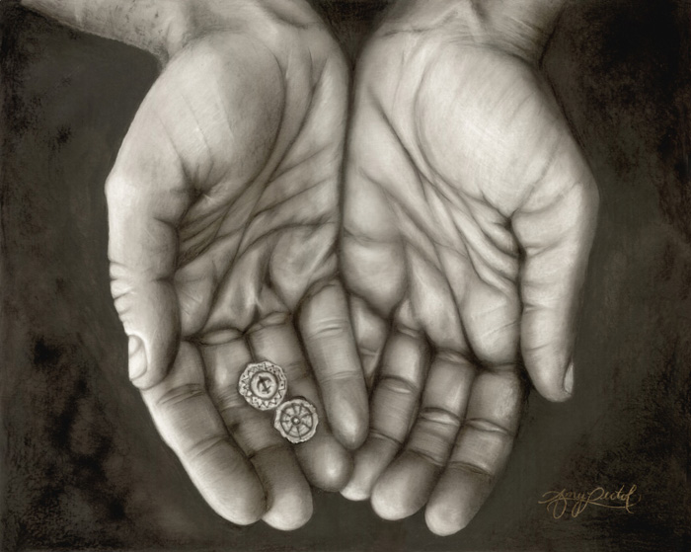

Slide 2
Thirty-second Sunday in Ordinary Time
Welcome:
Today we hear about a woman who did something very special. And we think about how we can share from what we have, no matter how little that is.

Slide 3
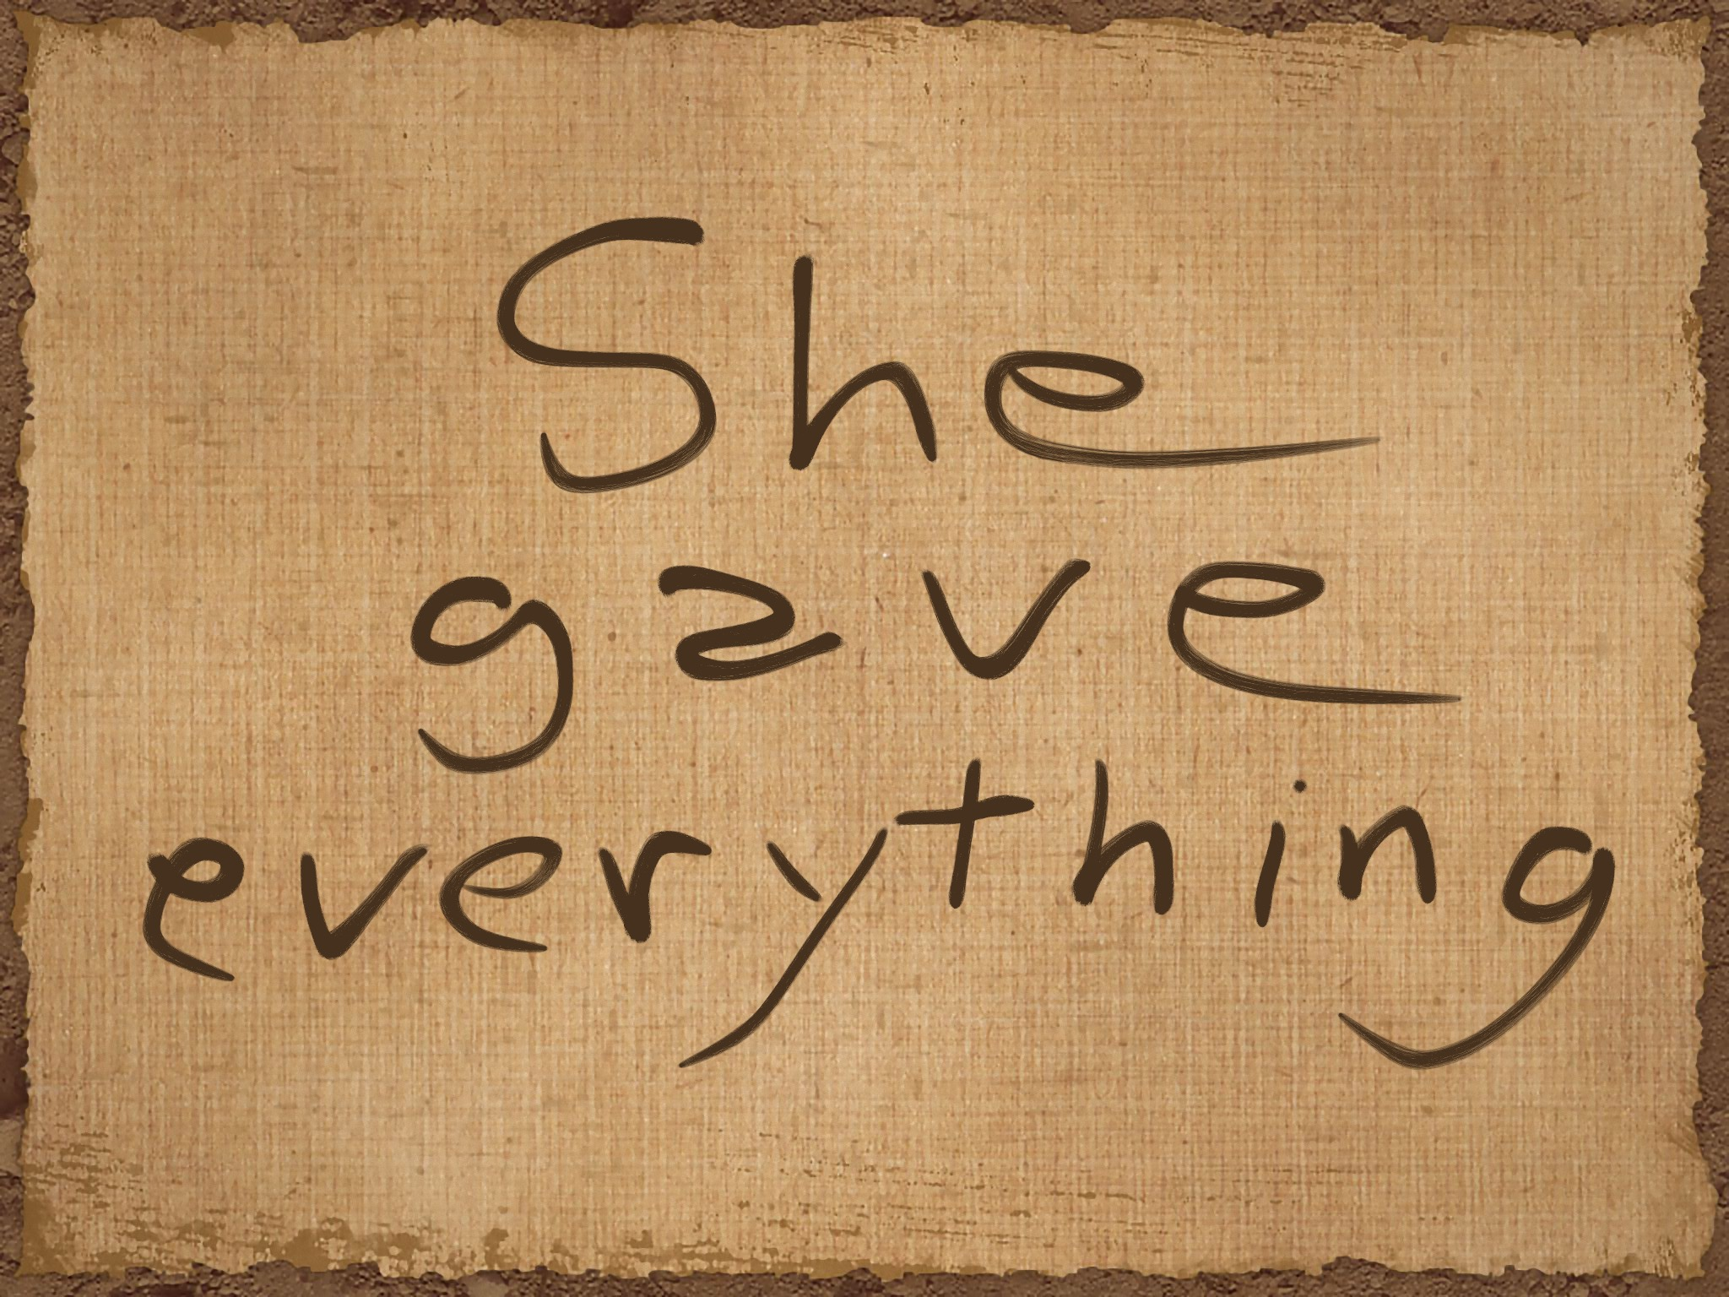

Slide 4
Opening Prayer
Generous God,
help us to share what we have, so that all people may have enough.
Amen.

Slide 5
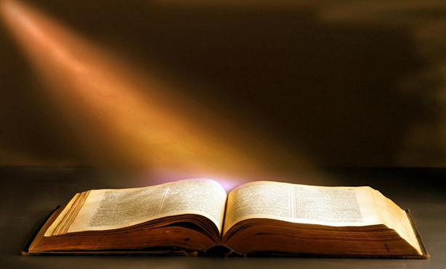
Gospel Acclamation
Alleluia, Alleluia, Praise the Lord
Alleluia, Alleluia, Praise the Lord
As we listen to the Story
Let us praise him for his glory
Alleluia, Alleluia Praise the Lord

Slide 6
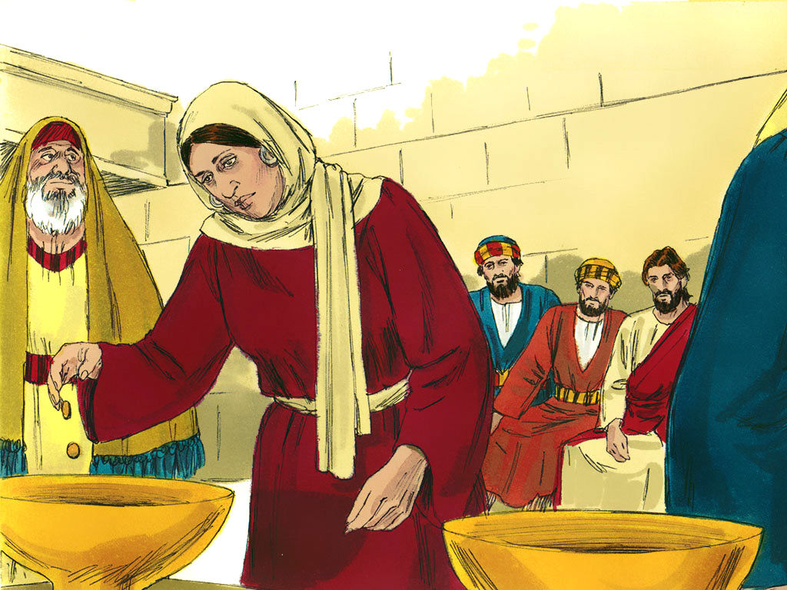
A reading from Gospel: Mark 12:38-44

Slide 7
Mark 12:38-44
As he taught them, [Jesus] said, “Watch out for the teachers of the Law, who like to walk around in their long robes and be greeted with respect in the marketplace, who choose the reserved seats in the synagogues and the best places at feasts. They take advantage of widows and rob them of their homes, and then make a show of saying long prayers. Their punishment will be all the worse!”
As Jesus sat near the temple treasury, he watched the people as they dropped in their money. Many rich men dropped in a lot of money; then a poor widow came along and dropped in two little copper coins, worth about a penny. He called his disciples together and said to them, “I tell you that this poor widow put more in the offering box than all the others. For the others put in what they had to spare of their riches; but she, poor as she is, put in all she had—she gave all she had to live on.”

Slide 8
Gospel Acclamation
Alleluia, Alleluia, Praise the Lord
Alleluia, Alleluia, Praise the Lord
As we listen to the Story
Let us praise him for his glory
Alleluia, Alleluia Praise the Lord

Slide 9
Reflection
What do you remember from today’s reading?
James and John ask to sit by Jesus’ side in heaven, but Jesus says he is not able to give them these seats.
The other disciples start to get cross with James and John. Why do you think they get cross?
The disciples felt that James and John were showing off and that James and John thought they were the best and most important disciples.
Can you think of a time when you got angry because someone else was showing off about how important they are? Perhaps someone was showing off that they were the best footballer or that they had better shoes or toys than you?
Can you remember what Jesus said to the disciples to stop them from being angry at each other?

Slide 10

Reflection
What do you remember from today’s reading?
Jesus was watching people putting money in the collection box at the synagogue. He saw some rich people putting in lots of money. They he saw a widow, who was poor, putting in two small coins, the same as a penny.
What did Jesus say to the disciples about the woman?

Slide 11
Reflection
The woman gave everything that she had. While the people who had lots of money just gave a little bit of what they had left over.
Which do you think Jesus would like us to be more like, the poor widow or the rich people? Why?
Jesus wants us to be generous and to share what we have with others. This is hard but we need to think – are we holding on to more than we need, like the rich people in Jesus’ story? Could we give a bit more or have we shared what we have?
Can you think of something that you can give and share with others?

Slide 12
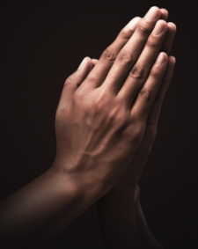
Intercessions
Let’s pray together:
We are called to be generous and share what we have with each other, and so we pray together:
We pray for world leaders: that they may be generous and fair, so that all their people have enough to live free from poverty. Lord, in your mercy…
We pray for all members of our global family: that we may see that all people have something important to share, no matter how small or unimportant it seems at first. Lord, in your mercy…
We pray for our parish, family and friends: that we may be as generous as possible, not keeping more of anything than we need, so that everyone may have enough. Lord, in your mercy…

Slide 13

Closing Prayer
God of light,
help us to share generously and to see how important and special each person’s gifts are.
Amen.

Slide 14


Slide 15
Commissioning
Go forth: Think about what you have heard today.
Share all that you have heard and thought about with the people at home and be as generous as possible and share with others in the coming week.

