Slide 1
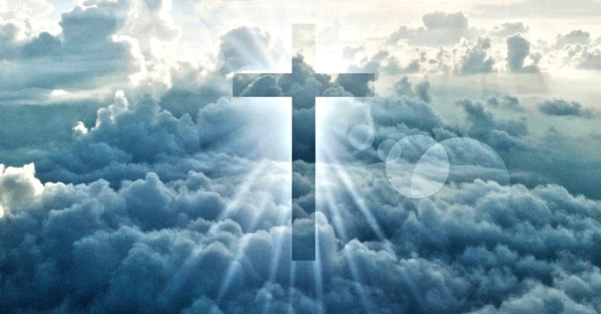

Slide 2
Thirty third Sunday of Ordinary Time
Welcome:Today we hear about the time when Jesus will come again. We do not know when this will be, but we must try to be ready. Let’s think a bit about how we get ready for other special events in our lives today…

Slide 3
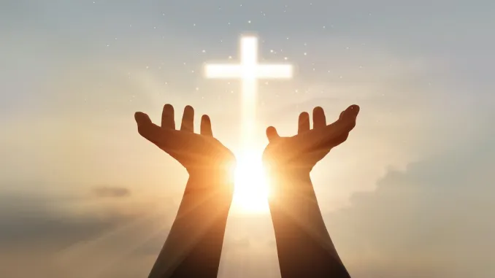
Opening Prayer
Christ Jesus, we know that one day you will come again. Help us to be ready when the time comes. Amen.

Slide 4
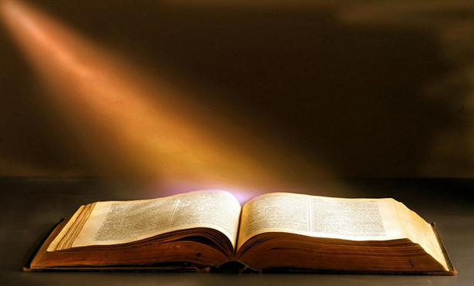
Gospel Acclamation
Alleluia, Alleluia, Praise the Lord
Alleluia, Alleluia, Praise the Lord
As we listen to the Story
Let us praise him for his glory
Alleluia, Alleluia Praise the Lord

Slide 5
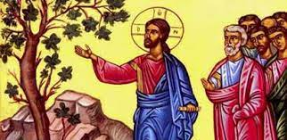
A reading from the Gospel according to Mark 13:24-32

Slide 6
“In the days after that time of trouble the sun will grow dark, the moon will no longer shine, the stars will fall from heaven, and the powers in space will be driven from their courses. Then the Son of Man will appear, coming in the clouds with great power and glory. He will send the angels out to the four corners of the earth to gather God's chosen people from one end of the world to the other.
“Let the fig tree teach you a lesson. When its branches become green and tender and it starts putting out leaves, you know that summer is near. In the same way, when you see these things happening, you will know that the time is near, ready to begin. Remember that all these things will happen before the people now living have all died. Heaven and earth will pass away, but my words will never pass away.
“No one knows, however, when that day or hour will come—neither the angels in heaven, nor the Son; only the Father knows.”

Slide 7
Gospel Acclamation
Alleluia, Alleluia, Praise the Lord
Alleluia, Alleluia, Praise the Lord
As we listen to the Story
Let us praise him for his glory
Alleluia, Alleluia Praise the Lord

Slide 8
Reflection
We often prepare for special events. Can you think of some events that we get ready for?
In today’s gospel Jesus talks about the time when he will come again. Do you remember what he says about when that will be?
Jesus says that nobody except God knows when Jesus will come again. But as his followers we should still try to be ready to greet him when he comes. How do you think we can be ready for Jesus? What kind of people should we be so that we are ready for Jesus?

Slide 9
Reflection
We can try to be ready by doing all that Jesus asks of us. By loving God and one another and by helping other people. By living in peace with each other and by sharing what we have so that all people have enough.
What will you do so that you can try to be ready when Jesus comes again in glory?

Slide 10
Intercessions
We do not know when Jesus will come again, so we pray together:
We pray for the Church throughout the world: that it may be an example of generous and welcoming love for all people, leading the way for when Jesus comes again. Lord, in your mercy…
We pray for all children around the world: that they may have the chance to go to school, to learn and prepare for the future. Lord, in your mercy…
We pray for our parish, family and friends: that we may always try to be kind, loving and generous to others, so that we may be ready when Jesus comes again. Lord, in your mercy…

Slide 11

Closing Prayer
God of power, show us how to live in peace and harmony with each other, so that we may be ready to welcome your Son Jesus when he comes again in glory. Amen

Slide 12
Commissioning
Go forth: Share all that you have heard and thought about today with the people at home. Do your best to try and live so that you will be ready for Jesus when he comes again.

