Slide 1
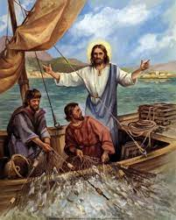
5th Sunday of Ordinary Time Welcome: Today we hear about something special that happened when Jesus went fishing, and how the fishermen left everything to follow him. Let’s think a bit about how we can follow Jesus in our lives today…
.

Slide 2
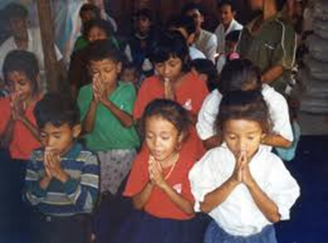
Opening Prayer
God of love, give us the strength and courage to follow your Son Jesus in all that we say and do. May our words and actions spread your message of love for all people. Amen.

Slide 3
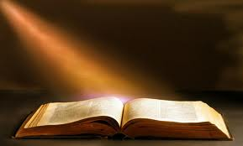
Gospel acclamation
Alleluia, Alleluia, Praise the Lord
Alleluia, Alleluia, Praise the Lord
As we listen to the Story
Let us praise him for his glory
Alleluia, Alleluia Praise the Lord.

Slide 4
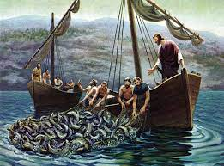
Gospel: Luke 5:1-11

Slide 5
Gospel acclamation
Alleluia, Alleluia, Praise the Lord
Alleluia, Alleluia, Praise the Lord
As we listen to the Story
Let us praise him for his glory
Alleluia, Alleluia Praise the Lord.

Slide 6
Time to reflect……
What do you remember from the reading today?
Jesus borrows Simon’s boat so that he can teach the crowds that are around him on the shore. When he has finished speaking he tells Simon Peter to put out his fishing nets into the water.
Do you remember what Simon says? He does not think they will catch anything. They haven’t caught anything all night.
What happens when Simon Peter and his friends put out the nets? They catch so many fish, and they are so heavy, the boat nearly sinks! How do you think Simon, James and John feel when they see this?

Slide 7
Intercession
We now offer our prayers to God:
We pray for world leaders: that they may seek the truth and so bring peace to the world. Lord, in your mercy…
We pray for all fisherfolk throughout the world: that they may stay safe while out on the water and catch enough fish to meet their needs. Lord, in your mercy…
We pray for our parish, families and friends: that we may follow Christ and show our faith in our words and in our actions. Lord, in your mercy…

Slide 8
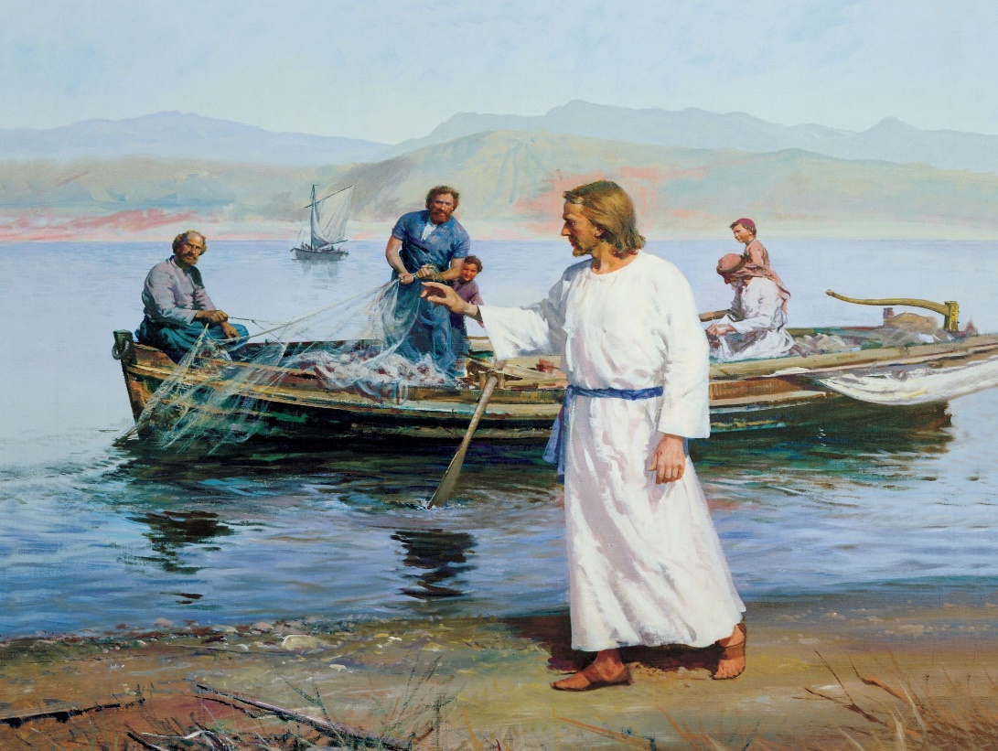
Hymn – Here I am, Lord or Follow me, follow me

Slide 9
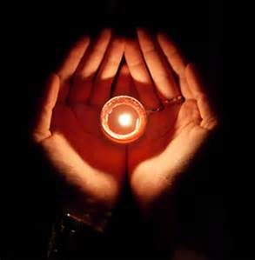
Closing Prayer
Loving God, may we try our best to follow your Son and to serve you faithfully each day, in what we do and how we treat others, especially our brothers and sisters who are poor.
Amen.

