Slide 1

Jesus is the light of the World

Slide 2
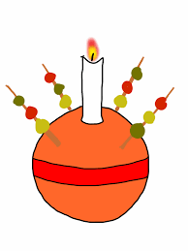
Christingle
Red ribbon represents-The blood of Christ- he died on the cross for us
Candle
Jesus is the light of the world
Orange represents the world
Sweets and raisins reminds us of God’s goodness in feeding us throughout the year.

Slide 3
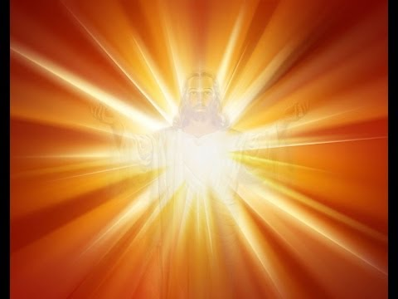
Share the light of Jesus
Share the light……
Share the word…..
Share the love…..
Share the smile……
Share the light……

Slide 4
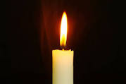
Alleluia, Alleluia, Praise the Lord
Alleluia, Alleluia, Praise the Lord
As we listen to the Story
Let us praise him for his
glory
Alleluia, Alleluia Praise
the Lord

Slide 5
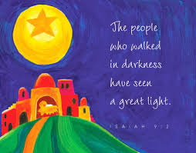

Slide 6

Alleluia, Alleluia, Praise the Lord
Alleluia, Alleluia, Praise the Lord
As we listen to the Story
Let us praise him for his
glory
Alleluia, Alleluia Praise
the Lord

Slide 7
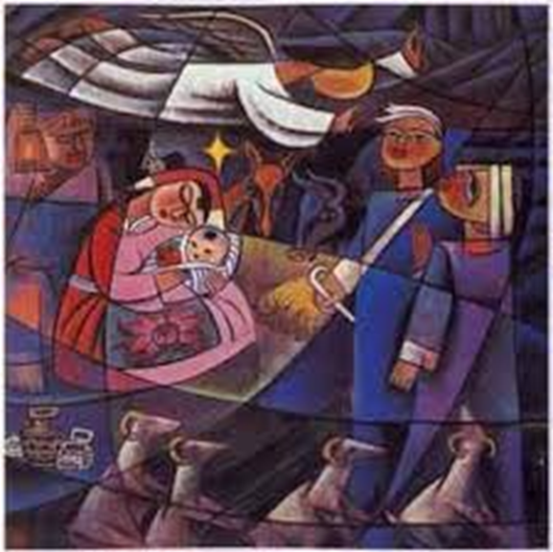
Isaiah 9
I wonder what you heard in the reading today?
I wonder who the child is that Isaiah said will be born?
I wonder who the light will be that will brighten up the world?
I wonder how we can prepare and get ready for Jesus’ birth?

Slide 8
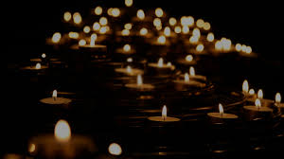
Let us Pray
May God our Father
Grant us the light of Christ
That we may shine with
His love during Advent
Help us to understand gift in a different way
Like giving the gift of our time, our presence or our prayer
How is our heart getting ready for Jesus?
Help us Lord to use the treasures in our hearts to think about others during Advent and to find some quiet time for prayer
Amen

Slide 9
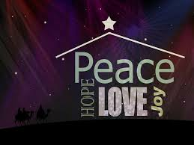
We wish everyone Joy
We wish everyone happiness
We wish everyone peace
We wish everyone health
We wish everyone hope.
We wish everyone Love.
We wish everyone kindness.
We wish everyone respect.
We wish everyone plenty

Slide 10
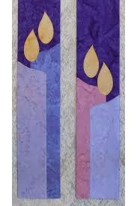
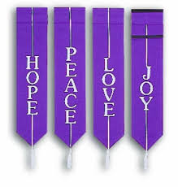
We wish everyone plenty.
We wish everyone friendship
Above all, we wish everyone God’s blessing.

Slide 11
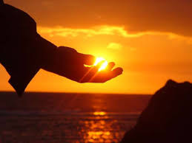
This little light of mine
I’m going to let it shine
This little light of mine
I’m going to let it shine
This little light of mine
I’m going to let it shine
Let it shine
Let it shine
Let it shine

Slide 12

On Monday he gave me the gift of Love
Tuesday peace came from above
On Wednesday he told me to have more faith
Thursday he gave me a little more grace
On Friday he told me to watch and pray
Saturday he told me just what to say
Sunday he gave me the power divine
To let my little heart shine
This little light of mine
I’m going to let it shine
This little light of mine
I’m going to let it shine
This little light of mine
I’m going to let it shine
Let it shine
Let it shine
Let it shine

